Slide 2
F5: Technology to Enable Your Multi-Cloud Journey
THR1123
Gregory Coward, Solution Architect – F5 Networks

Slide 3

Centralized Management with BIG-IQ
Device Management
APIs
Operational Management
Policy Management
Security Management Visibility and Reporting

Slide 4
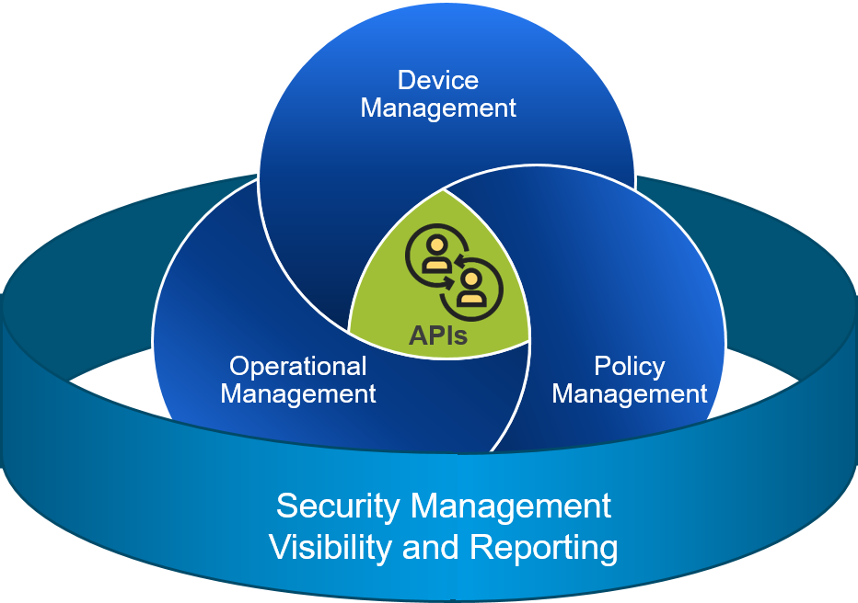
Centralized Management with BIG-IQ
Manage F5 devices regardless of location
Configure LTM, APM, Advanced WAF, AFM
Monitoring DNS and Web Safe
Performance and health dashboards
License management
Backup and restore images and configurations
Central reporting and alerting
Audit trails

Slide 5
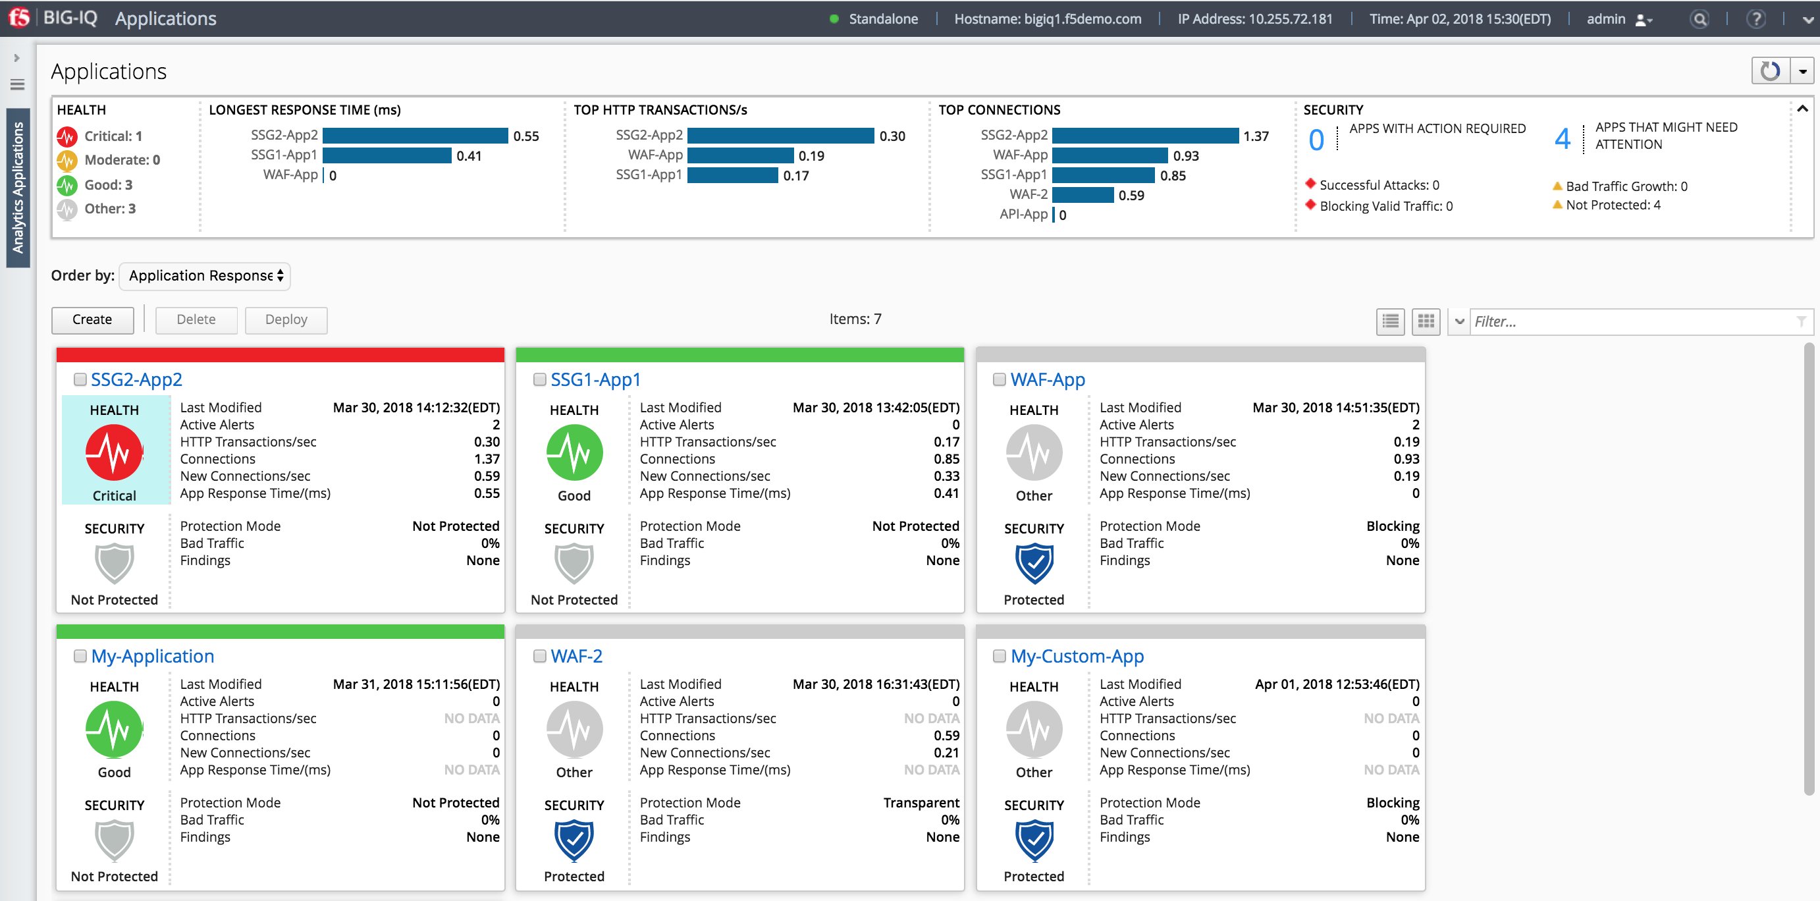
BIG-IQ Analytics for Applications
Real Time Displays of TopN
Filters
Apps can deployed on SSG or BIG-IP

Slide 6



Putting F5 in Your Toolbox
SIMPLIFY, AUTOMATE, AND CUSTOMIZE APPLICATIONS FASTER AND MORE PREDICTABLY
Automates continuous cloud-based app delivery
F5 CI/CD Toolchain Insertion
Supports the secure delivery of large data loads
Ensures application availability with no impact from traffic fluctuations
Keeps cloud-based single app delivery fast, available, and secure
F5 BIG-IP Advanced WAF VE
F5 BIG-IP LTM VE
Auto-Scale
F5 BIG-IP LTM Per-App VE
Notes:
Using BIG-IP APM as the AD FS Proxy means that IT benefits from the simplified solution by:
Reducing cost and management complexity
Enabling advanced security and reducing the risk of weak links by removing WAP
Requiring only half of the number of servers with no additional DMZ servers required
Providing all use cases with full support for MS-ADFSPIP protocol to act as AD FS proxy

Slide 7
Demo
Orchestrating a Multi-Cloud Solution
with F5 BIG-IQ and Jenkins

Slide 8


Multi-Cloud | F5demo
public cloud | Azure
North EUROPE
F5 Technology Used
Traffic Management
Global Server Load Balancing
Location Based Routing
Load Balancing
IPSec Tunneling
Orchestration
Jenkins
Application Management
License Management
Analytics
Private Cloud | On-prem
Security
Web Application Firewall
8

Slide 9
Multi-Cloud | F5demo
public cloud | Azure
North EUROPE
Public Cloud | Azure
US EAST
Private Cloud | On-prem
9

Slide 10
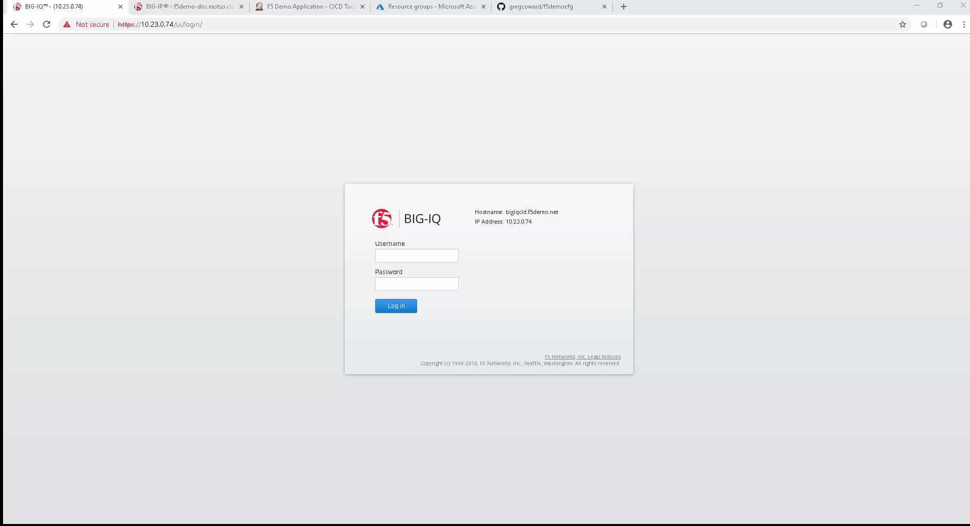

Slide 11
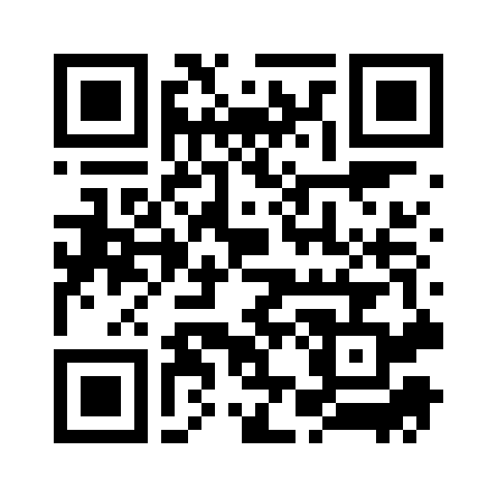
Please evaluate this session Your feedback is important to us!
This slide is required. Do NOT delete or alter the slide.
The slide will be replaced onsite through Silver Fox Productions with an updated QR code.
From your PC or Tablet visit MyIgnite at http://myignite.microsoft.com
From your phone download and use the Ignite Mobile App by scanning the QR code above or visiting https://aka.ms/ignite.mobileapp

